Slide 1


Movie Database
Aruna Rao
Evan Wilson
Kristina Sorrelli
Sampada Gandhe

Slide 2


THE MOVIE DATABASE TMDb
Data from 1960 -2009
English Language

Slide 3

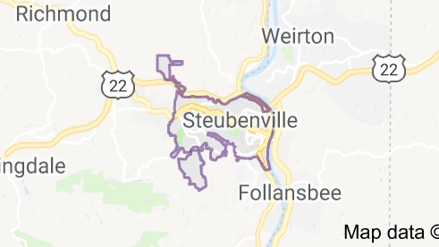

QUESTIONS:
Where do the actors or actresses come from?
World and United States?
What states in the US?

Slide 4


WHY THIS QUESTION?
The Guardian Article
Hollywood fears of origin of artists

Slide 5


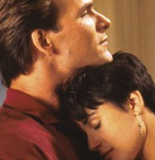


Hypothesis:
Expected to see most artists today are either from California and/or New York
Expected that in the 60’s people were from all over the world
As decades passed we thought the concentrations would be found in CA/NY

Slide 6
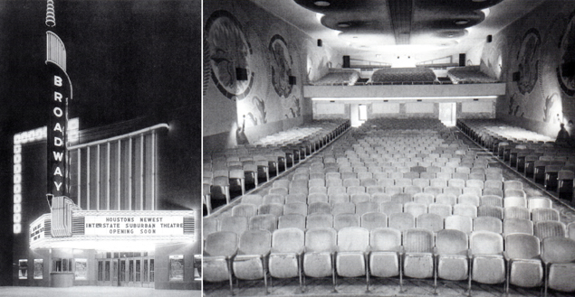



TMDB – Discover:
Can be used to generate a list of movies based on various criteria
We used this API to get a list of the top 20 movies per year by revenue from 1960 to 2009
We then broke the data up by decade

Slide 7



TMDB – Credits:
Returns the full cast and credits for a movie
We used this API to find the top two billed cast members for each movie

Slide 8


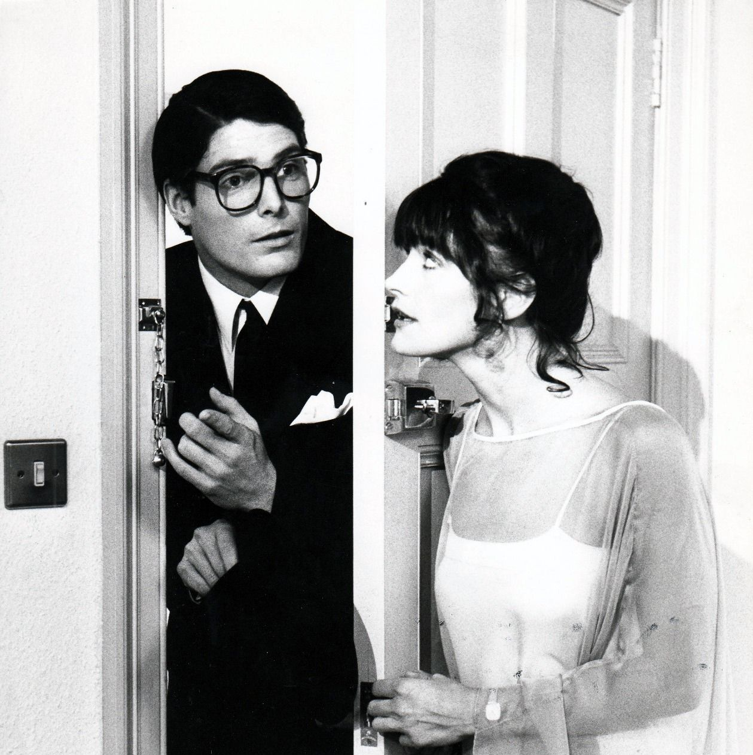

TMDB – Person:
Can be used to get details of an individual actor or actress, ranging from name and age to a brief biography
We used this API to find the birthplace of each actor/actress

Slide 9
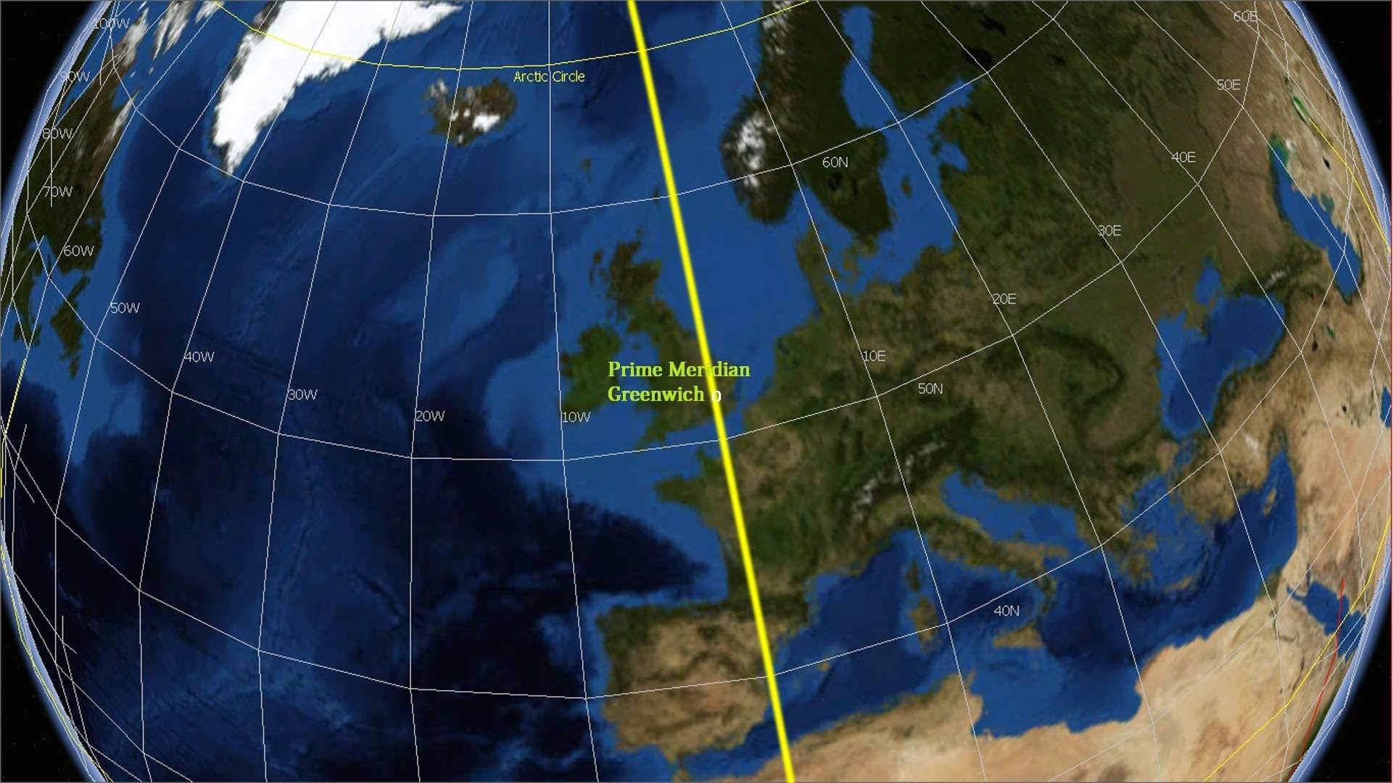
Google Maps Text Search:
Returns place details from a text string that can have variable syntax
We used this to retrieve a latitude and longitude of the birthplaces, even if the location was ambiguous

Slide 10
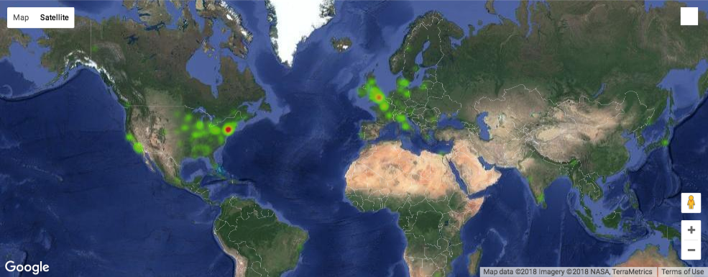
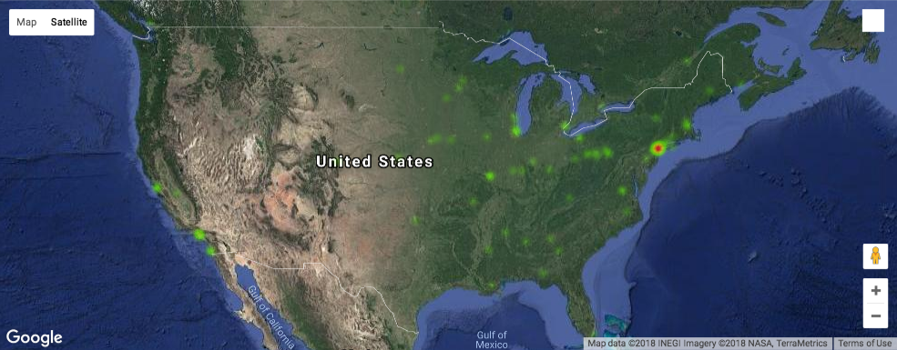
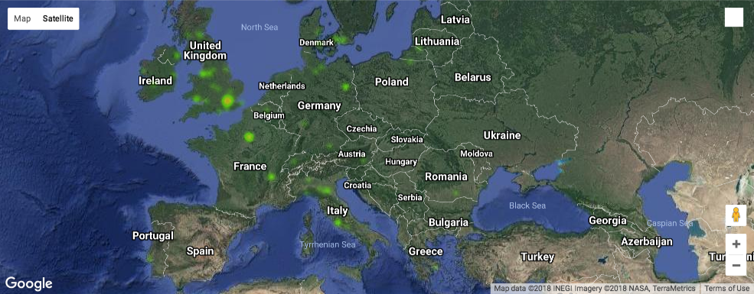
Plotting the Data:
Given the large amount of data centered on the same few points we chose to plot a heatmap
Gmaps was used to create an interactive heatmap overlaid on a world map
We took images of regions of interest, as well as a worldwide heatmap
We repeated the same regions for each decade to make comparisons

Slide 11

Actor/Actress Birthplace Heatmaps:
RECAP
We utilized the 20 highest grossing movies for each decade, gathering the lead actor/actress for each movie.
Collected data to define where each actor/actress was born.
Created heatmaps representing where each individual was born.
This allowed us to see the migration of birthpace locations over 50 years, by decade.

Slide 12

1960 Heatmaps:
USA–Europe–World

Slide 13
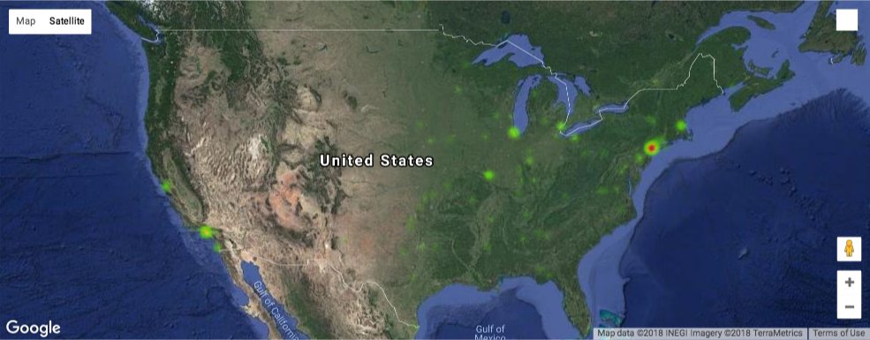

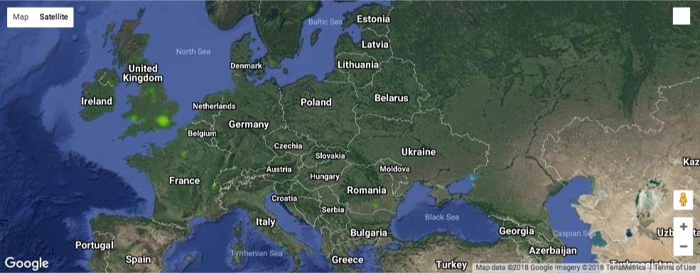
1970 Heatmaps:
USA–Europe–World

Slide 14
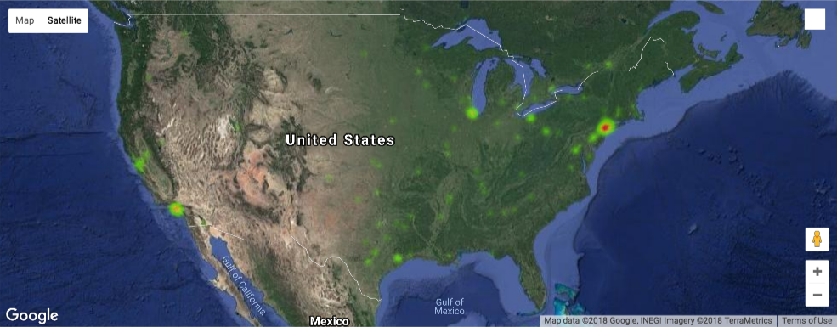
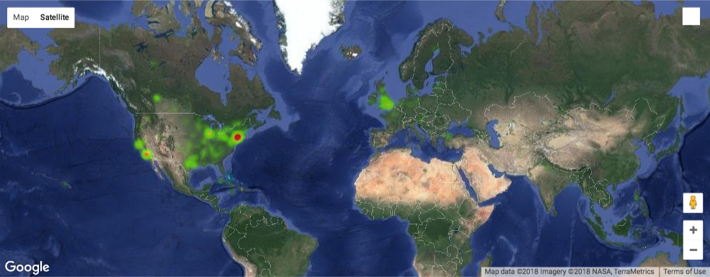
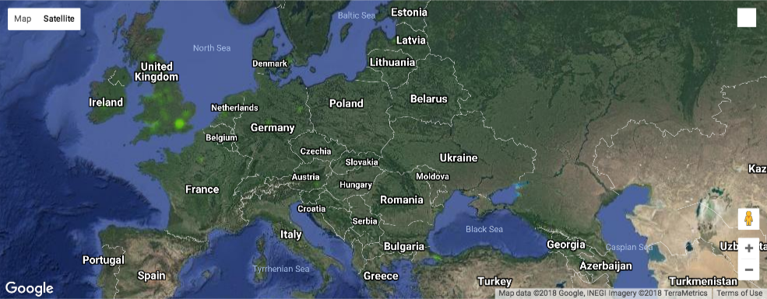
1980 Heatmaps:
USA–Europe–World

Slide 15
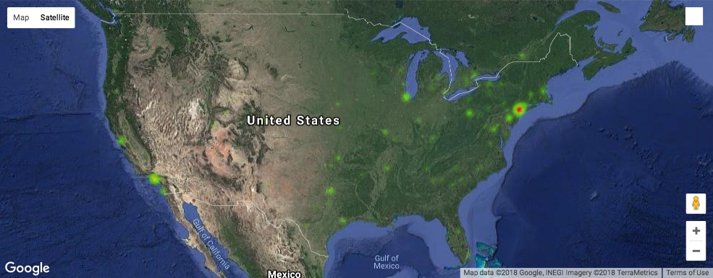
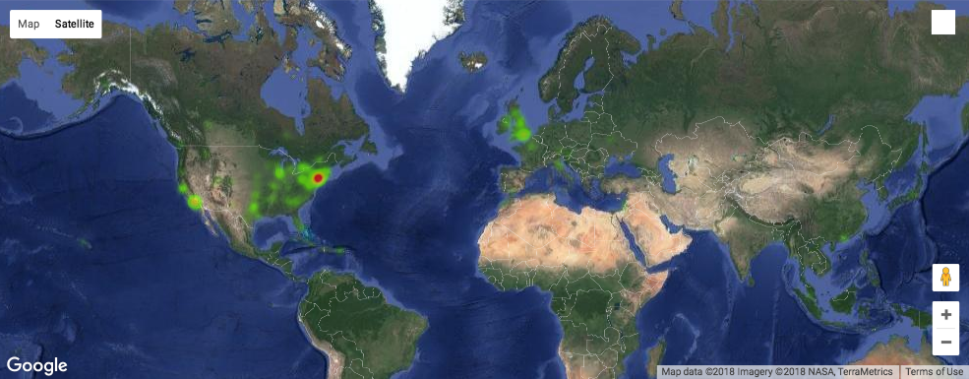
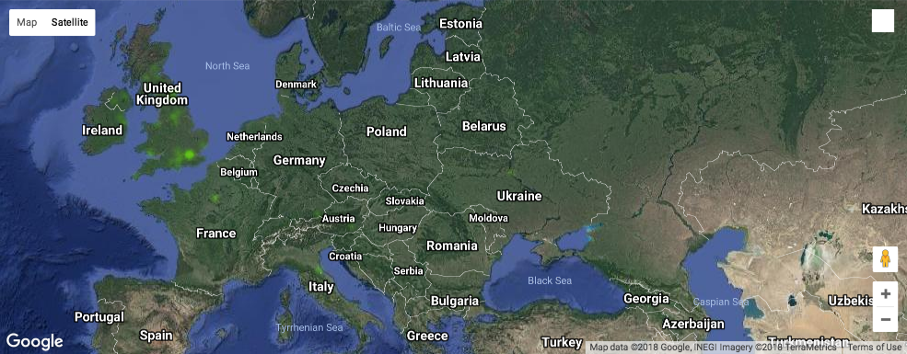
1990 Heatmaps:
USA–Europe–World

Slide 16
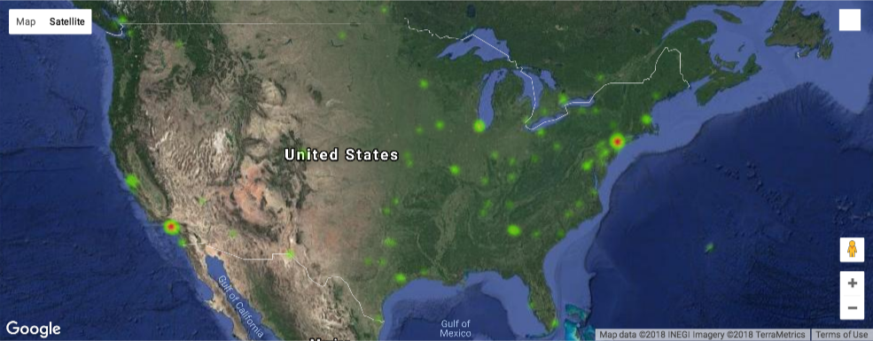
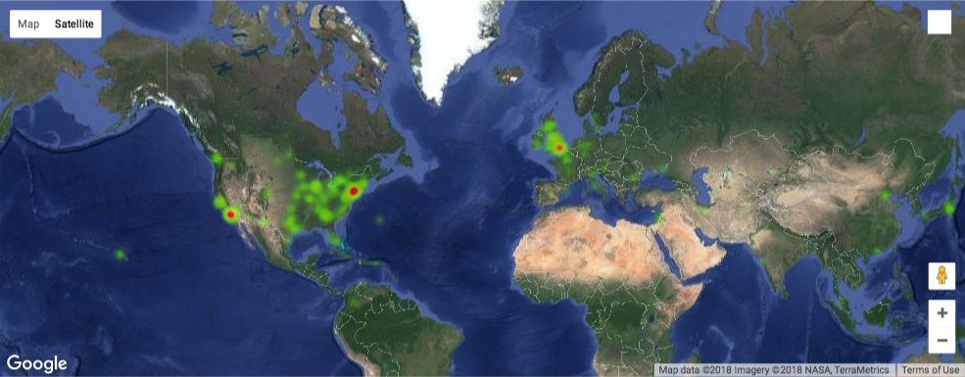

2000 Heatmaps:
USA–Europe–World

Slide 17
1960/1980/2000
Heatmaps: USA

Slide 18
1960/1980/2000
Heatmaps: Europe

Slide 19
1960/1980/2000
Heatmaps: World

Slide 20

conclusion
Our assumptions were correct!

